Slide 1
Data Wrangling Part 1
EEOB590A
September 20, 2021

Slide 2
Outline
Wrangle! Week 1 (Chapters 9 - Intro, 10 - Tibbles)
Learn how to pipe %>% (Chapter 18)
Fix column names (rename())
Get into tidy structure by reshaping dataframe (Ch 12, 13)
Separate (), unite ()
Pivot_wider(), pivot_longer()
Fill in missing values – spread (), complete (), fill()
Combine tables (bind_cols(), bind_rows(), ___join())
Wrangle! Week 2 (Chapters 3, 11, 12, 13)
Fix information within cells (levels, spaces, case etc.), group, summarize, arrange

Slide 3
Next week – fixing cells & manipulating overall dataset
Fix values within a column
Fix complex values within cells using stringr
Fix factor levels using forcat & classes
Fix dates using lubridate
Create new columns (mutate())
Manipulate overall dataset
Make smaller: Subset rows (filter()) or columns (select())
Group data (group_by)
Summarize data (summarise(), count())
Re-arrange: arrange data by the levels of a particular column (arrange())

Slide 4
Data wrangling
Now we start Double-checking/ Cleaning/ Munging/ Wrangling/ Tidying
Reproducibility is key (therefore do it in a script)
Always check wrangled data against raw data to make sure things ran as you expected
Order of wrangling:
Fix column names
Tidy (Re-shape) dataframe (wide, long)
Fix cells (levels, spaces, case etc.)

Slide 5
Fix column names
Tidyverse – dplyr - function rename()
Rename(new name = old name)

Slide 6
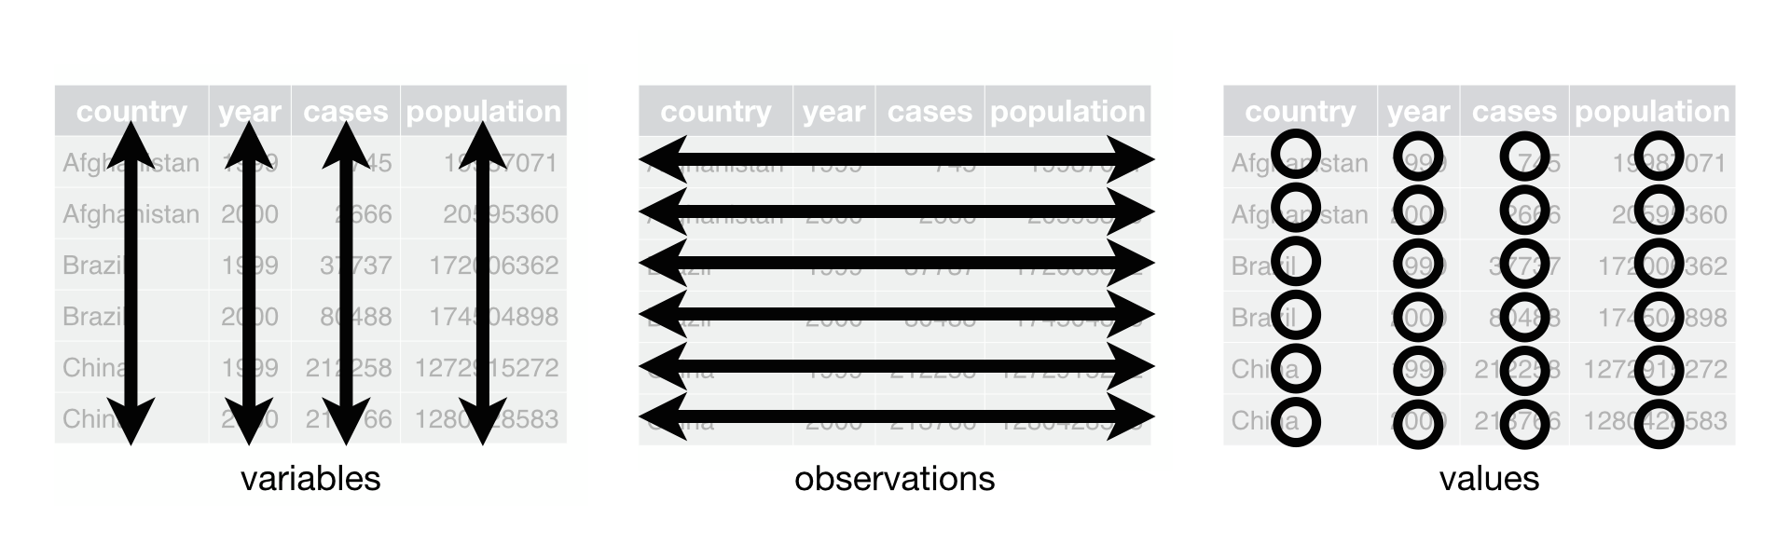
Tidy Data

Slide 7
Look at Hadley’s Tidy paper
Common problems
Column headers are values, not variable names.
Multiple variables are stored in one column.
Variables are stored in both rows and columns.
Multiple types of observational units are stored in the same table.
A single observational unit is stored in multiple tables.

Slide 8
A tibble: 12 x 4
country year type count
<chr> <int> <chr> <int>
1 Afghanistan 1999 cases 745
2 Afghanistan 1999 population 19987071
3 Afghanistan 2000 cases 2666
4 Afghanistan 2000 population 20595360
5 Brazil 1999 cases 37737
6 Brazil 1999 population 172006362
7 Brazil 2000 cases 80488
8 Brazil 2000 population 174504898
9 China 1999 cases 212258
10 China 1999 population 1272915272
11 China 2000 cases 213766
12 China 2000 population 1280428583
# A tibble: 6 x 4
country year cases population
<chr> <int> <int> <int>
1 Afghanistan 1999 745 19987071
2 Afghanistan 2000 2666 20595360
3 Brazil 1999 37737 172006362
4 Brazil 2000 80488 174504898
5 China 1999 212258 1272915272
6 China 2000 213766 1280428583
# A tibble: 6 x 3
country year rate
* <chr> <int> <chr>
1 Afghanistan 1999 745/19987071
2 Afghanistan 2000 2666/20595360
3 Brazil 1999 37737/172006362
4 Brazil 2000 80488/174504898
5 China 1999 212258/1272915272
6 China 2000 213766/1280428583
# A tibble: 3 x 3
country `1999` `2000`
* <chr> <int> <int>
1 Afghanistan 745 2666
2 Brazil 37737 80488
3 China 212258 213766
Only one of these is tidy. Which one and why?
Notes:
Only table 1 is tidy. Why?

Slide 9
Piping
%>% symbol
Part of tidyverse
Replaces order of operations-style coding
#Here are four reasons why you should be using pipes in R:
You'll structure the sequence of your data operations from left to right, as apposed to from inside and out;
You'll avoid nested function calls;
You'll minimize the need for local variables and function definitions;
You'll make it easy to add steps anywhere in the sequence of operations.

Slide 10
Reshape dataframe
2 columns into 1: unite()
1 column into 2: separate()
Long to wide: Pivot_wider()
Wide to long: Pivot_long()
Fill in missing values: complete(), fill()
Combine tables:
bind_cols(), bind_rows()
___ join() lots of options of types of joins

Slide 11
Pivot_wider
From data carpentry

Slide 12
Pivot_longer
From data carpentry

Slide 13
Joins

